Slide 1


SAVITRIBAI PHULE PUNE UNIVERSITY
JAYAWANTRAO SAWANT COLLEGE OF ENGINEERING, HADAPSAR,PUNE
Department of Computer Engineering Academic Year 2025-26
Project Stage-I
“RareDetect: AI Based System for Identifying Rare Brain Tumors”
Final Year of Computer Engineering
PROJECT GUIDE: Prof.S.C.Patle
Group Members: 1. Rushikesh Shiraskar
Piyush Borade
Rutuja Londhe
Samruddhi Sable

Slide 2
INDEX
Abstract
Introduction
Literature Review
Motivation & Gap Analysis
Project Description /Objective
Architecture Diagram
Mathematical Model
Design
Algorithm to be used
End user /Business Model
Application
Conclusion
References

Slide 3
ABSTRACT
Rare diseases are difficult to detect due to limited and imbalanced data. Existing CNN models like VGG16 and ResNet50 show good performance but face challenges in rare disease classification. To address this, we propose RareNet, a custom CNN model designed for accurate detection. The pipeline includes preprocessing, feature extraction, classification, and evaluation using metrics such as accuracy, precision, recall, and F1-score. RareNet provides a reliable AI-based support system for doctors and researchers in diagnosing rare diseases.

Slide 4
INTRODUCTION
Artificial Intelligence (AI) and deep learning have significantly advanced medical imaging, enabling faster and
more accurate diagnosis of diseases. Despite this progress, detecting rare brain tumors such as glioma,
meningioma, and pituitary tumors remains a challenge due to limited data availability and overlapping imaging features. To address this issue, the project titled RareNet proposes a custom deep learning model designed to classify brain MRI scans into four categories: glioma, meningioma, pituitary tumor, and no tumor.
The system will be trained using open-source datasets and standard preprocessing techniques like resizing, normalization, and augmentation. The performance of RareNet will be compared with well-known models such as VGG16 and ResNet50 using evaluation metrics including accuracy, precision, recall, and F1-score.

Slide 5
Literature Review
Sr. No. | Title | Year | Author | Remark | Gap Analysis
1 | Brain Tumor Detection using Deep Neural Networks | 2021 | Yakub Bhanothu, Anandhanarayanan Kamalakannan & Govindaraj Rajamanickam | Proposes a CNN model for MRI tumor classification achieving high accuracy using data augmentation. | Uses only one model, no comparison between architectures like VGG16 & ResNet50.
2 | Comparative Analysis of VGG16 and ResNet50 for Brain MRI Classification | 2022 | Md Ishtyaq Mahmud, Muntasir Mamun & Ahmed Abdelgawad | Benchmarks VGG16 and ResNet50 on MRI datasets, showing ResNet50 performs better. | Does not propose a new model to outperform both — stops at comparison.
i

Slide 6
3 | Custom CNN Architecture for Rare Brain Tumor Detection | 2020 | N. Jeenath Shafana O. & P. A. Senthil Selvi | Designs a lightweight CNN tailored for small datasets, achieving high accuracy without overfitting. | No benchmark comparison with both VGG16 and ResNet50 in the same study.
4 | An Analysis of Image Segmentation Methods for Brain Tumour Detection | 2020 | Anurag Goswami & Manish Dixit | Reviews MRI segmentation methods to improve tumor region detection before classification. | .Focuses on preprocessing, not architecture comparison or custom model development.

Slide 7
Problem Statement
Rare brain tumors often go undetected due to limited diagnostic data and lack of expert access, especially in rural areas. Manual MRI interpretation is time-consuming and prone to error. This project proposes an AI-based system using a custom deep learning model to classify brain MRI images into two categories—Tumor and Non-Tumor—and compares its performance with standard models like VGG16 and ResNet50 to evaluate improvements in accuracy and reliability.

Slide 8
MOTIVATION
Brain tumor detection is a critical and time-sensitive task in medical diagnosis. While deep learning has shown great success in medical imaging, most existing models perform well only on common cases with abundant data.
Rare brain tumors often go undetected or misclassified due to limited datasets and subtle visual differences, posing serious risks to patients.
This motivates the development of a specialized system that can accurately detect and classify rare brain tumors using MRI scans. By improving early and reliable diagnosis, this project aims to support radiologists and enhance clinical outcomes, especially for underrepresented and challenging tumor types.

Slide 9
Gap Analysis
Area | Current Situation | Gap / Limitation | Proposed Solution (Your Project)
Algorithms | Existing CNN models like VGG16 and ResNet50 perform well on common datasets. | Limited generalization for rare disease data due to small and imbalanced datasets. | Develop a model for optimized for small, imbalanced rare disease datasets.
Dataset Availability | Public datasets for rare diseases are limited and scattered. | Lack of sufficient labeled images reduces model accuracy. | Use public medical image datasets and apply data augmentation to increase dataset size and diversity.
Performance Benchmarks | Models are often compared only on accuracy. | Ignores deeper performance metrics like F1-score or recall, which are crucial for medical use. | Evaluate models using Accuracy, Precision, Recall, F1-score, and Confusion Matrix for better comparison.
Workflow Integration | Many studies focus only on model training without visualization or comparison | Hard to justify why one model outperforms another. | Integrate comparative visualization using graphs and performance tables for better interpretability.
Scientific Utility | Limited tools available for rare disease detection and analysis. | Lack of reliable AI support for early-stage diagnosis. | It provides an AI-based diagnostic support system to assist doctors and researchers in early detection.

Slide 10
Objective
The primary aim of this project is to develop a deep learning-based system for accurate detection and classification of rare brain tumors using MRI data.
To enhance the reliability of rare case detection and support early-stage diagnosis in medical systems through result analysis using graphs, tables, and performance curves.
To design and implement a custom deep learning model for accurate detection and classification of rare brain tumors using MRI data.

Slide 11
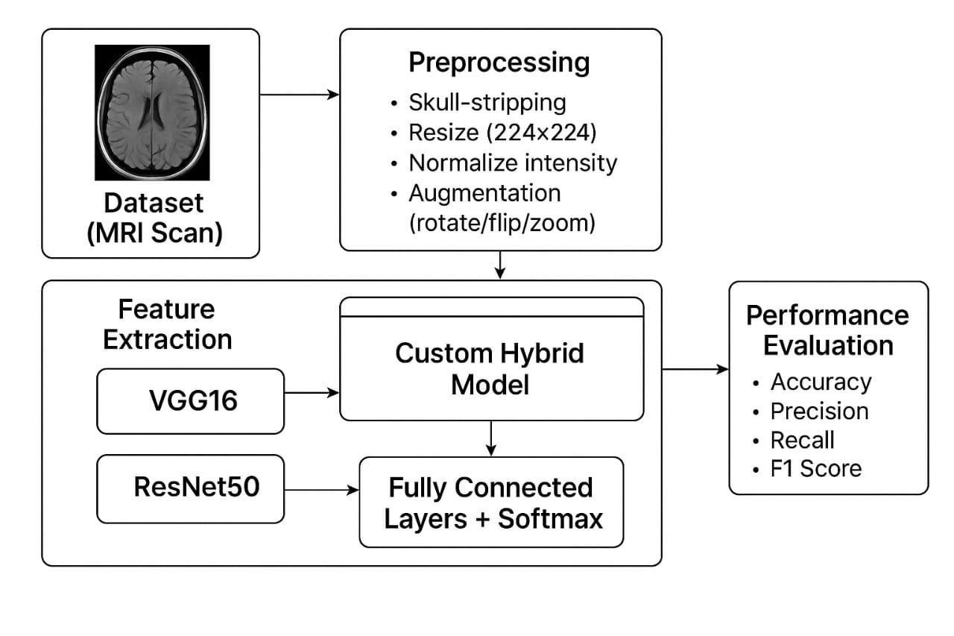
Architecture Diagram
Fig.1 Architecture Diagram

Slide 12
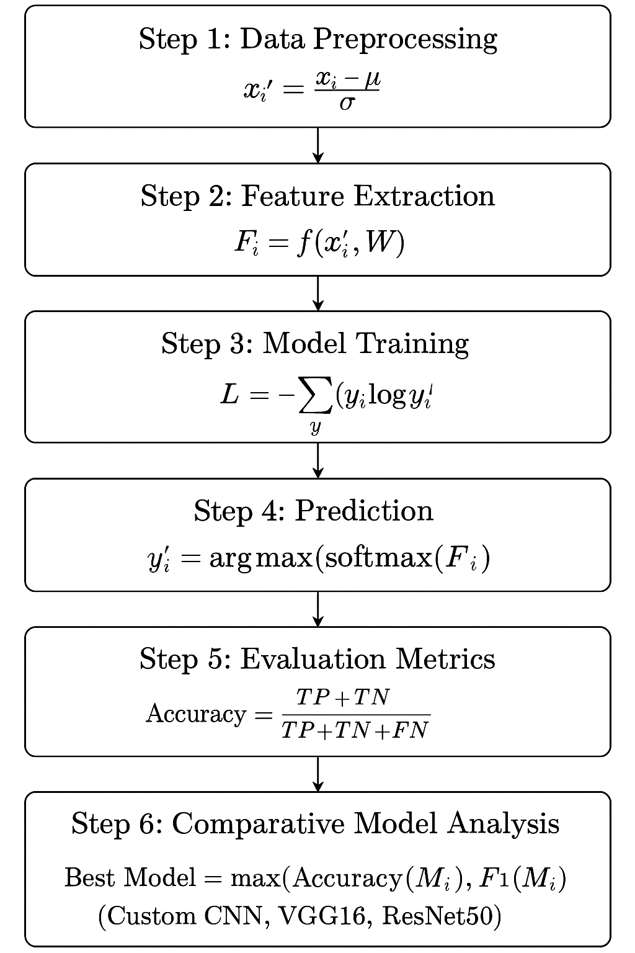
Mathematical Model
D = { (x₁, y₁), (x₂, y₂), …, (xₙ, yₙ) } The dataset. Each pair (xᵢ, yᵢ) means: • xᵢ = the i-th MRI image (matrix of pixel values). • yᵢ = the label for that image (one of: No Tumor, Tumor). There are n images in total.

Slide 13
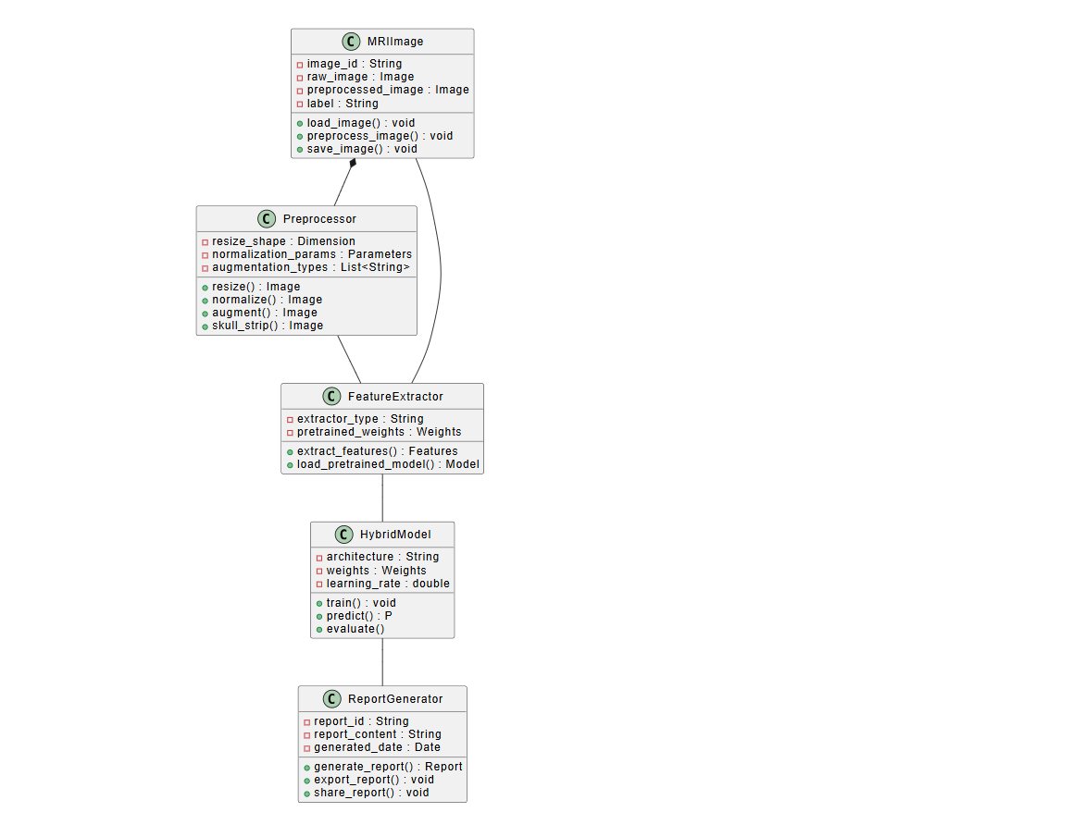
Class Daigram

Slide 14
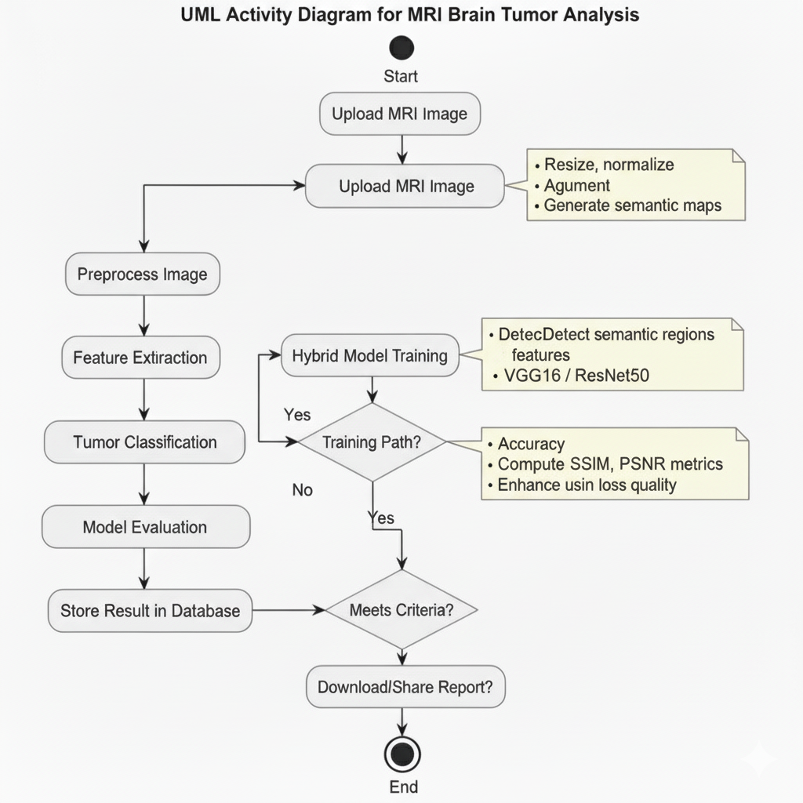
Activity Daigram

Slide 15
Algorithm to be used
Input medical image dataset
Preprocess images (resize, normalize, augment)
Apply Convolutional layers
Reduce dimensions
VGG16 → 16-layer CNN with 3×3 filters, widely used baseline.
ResNet50 → 50-layer CNN with skip connections, solves vanishing gradient.
Flatten feature maps → Fully connected layers
Apply Softmax for classification
Evaluate using Accuracy, Precision, Recall, F1-score
Compare results with existing models

Slide 16
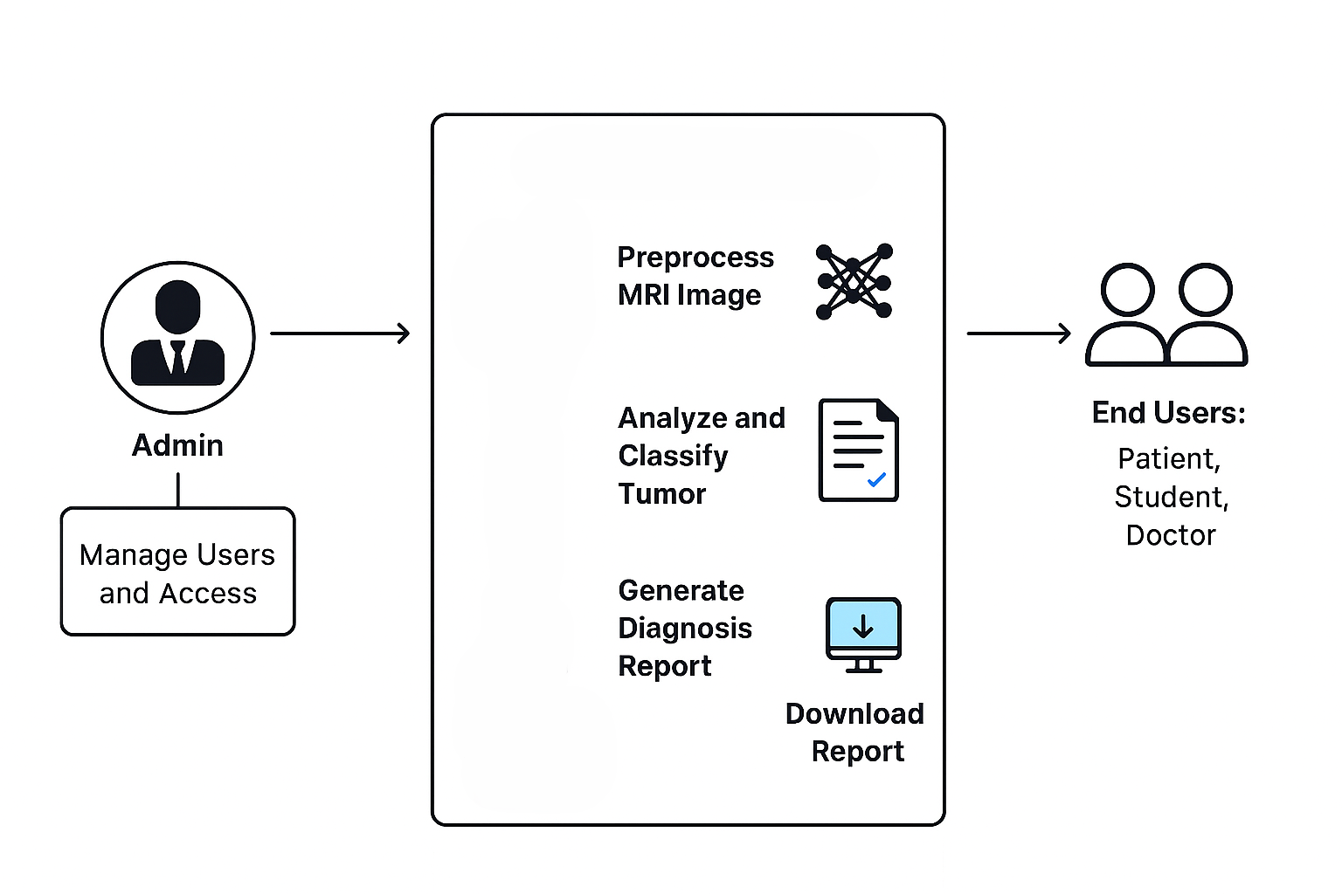
End user Model

Slide 17
CONCLUSION
The RareDetect project presents a focused and impactful solution to one of the most pressing challenges in
modern healthcare — the early detection of rare brain tumors. By applying deep learning to MRI image classification, the system seeks to enhance diagnostic accuracy while reducing dependency on manual
interpretation.
The development of a custom AI model, along with comparative analysis against standard architectures like VGG16 and ResNet50, provides both technical insight and practical value. The model is expected to perform
efficiently across various tumor types, particularly those that are rare or subtle, making it a strong candidate for real-world clinical support systems.
If successful, this system can be adapted for other rare disease applications and integrated into telemedicine platforms, particularly in underserved or remote areas.

Slide 18
References
[1] Kumar, D., Sethi, S., & Arora, A. (2020). Brain Tumor Detection Using Convolutional Neural Network.
International Journal of Engineering Research & Technology (IJERT), Vol. 9 Issue 8.
Rani, A., & Kaur, P. (2021). Deep Learning Based Brain Tumor Detection Using
MRI Images. International Journal for Research in Applied Science & Engineering Technology (IJRASET), Volume 9 Issue V.
Prajapati, J., Trivedi, H., & Patel, D. (2021). Brain Tumor Detection Using Convolutional Neural Network.
International Journal of Engineering Sciences & Research Technology, Volume 10 Issue 5.
Ali, S., Nandhini, K., & Nivedhitha, R. (2022). Brain Tumor Detection Using CNN and Transfer Learning. IEEE Xplore, 2022 International Conference on Computer Communication and Informatics (ICCCI).
Sahu, S., & Mahapatra, A. (2023). Comparative Study of Brain Tumor Classification Using Deep Learning
Models. International Journal of Advanced Computer Science and Applications (IJACSA), Volume 14 Issue 3.

Slide 19
Afshar, P., Mohammadi, A., & Plataniotis, K. N. (2020). Brain tumor type classification via capsule networks.
Expert Systems with Applications, 141, 112957.
Iqbal, S., Qureshi, S. A., & Javed, M. Y. (2021). Deep learning model for classification of glioma tumor subtypes using MRI data. Biomedical Signal Processing and Control, 63, 102172.
Rehman, A., Khan, M. A., Saba, T., & Mehmood, Z. (2022). Brain tumor classification using deep learning: A review. Healthcare Analytics, 2, 100041.
Islam, M., Zhang, Y., & Ren, H. (2023). Multi-class brain tumor classification using ensemble CNNs. Computers in Biology and Medicine, 154, 106594.
Lakkimsetty, V., & Ghanta, S. K. (2023). Transfer learning for brain tumor detection using fine-tuned ResNet
models. Materials Today: Proceedings, 80, 1144–1151.

Slide 20
THANK YOU

